Slide 1


ZOMATO RESTAURANT ANALYSIS
GROUP 03:
Pramodini Pagare
Ardra M
Rohan Palkar
Shaik Javeed Basha
Bhavana HB

Slide 2
Overview
The Zomato Restaurant Analysis Project examines restaurant data across different cities and regions, focusing on key factors like restaurant locations, cuisine preferences, pricing strategies, and customer satisfaction indicators. The analysis includes essential attributes such as the availability of online delivery, price range, and ratings, providing valuable insights into the operational dynamics of restaurants and customer trends. Temporal data on restaurant openings adds another layer of insights for strategic business planning.

Slide 3
Problem statement
Zomato, a leading restaurant aggregator, faces several challenges in optimizing restaurant operations and enhancing customer satisfaction. The key issues include a low average rating (2.89), limited online delivery adoption (25.66%), low table booking availability (12.12%), and geographical concentration of restaurants in specific cities. These factors impact customer experience, revenue growth, and market penetration.
The objective of this analysis is to identify patterns, trends, and gaps in restaurant performance and provide data-driven recommendations to improve service quality, increase digital adoption, and expand market reach.

Slide 4
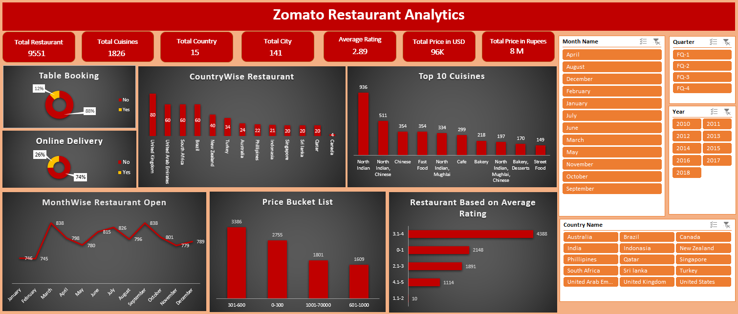
EXCEL DASHBOARD

Slide 5
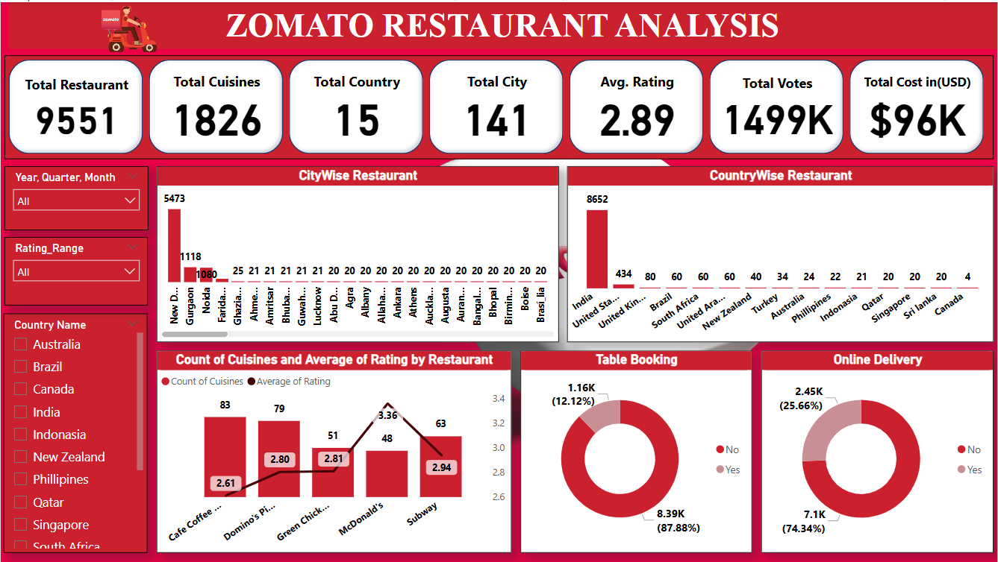
POWER BI DASHBOARD

Slide 6
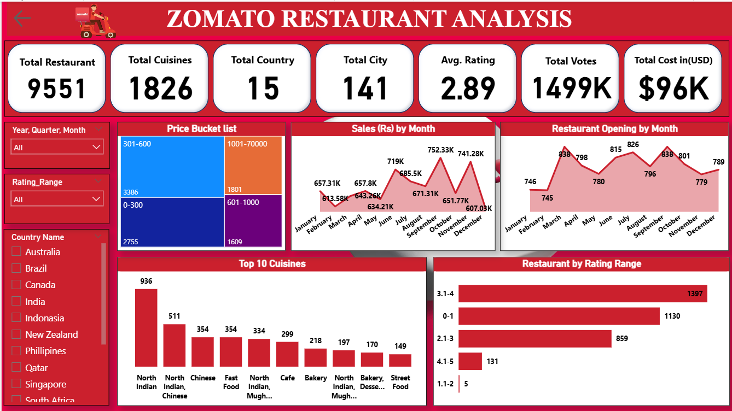

Slide 7
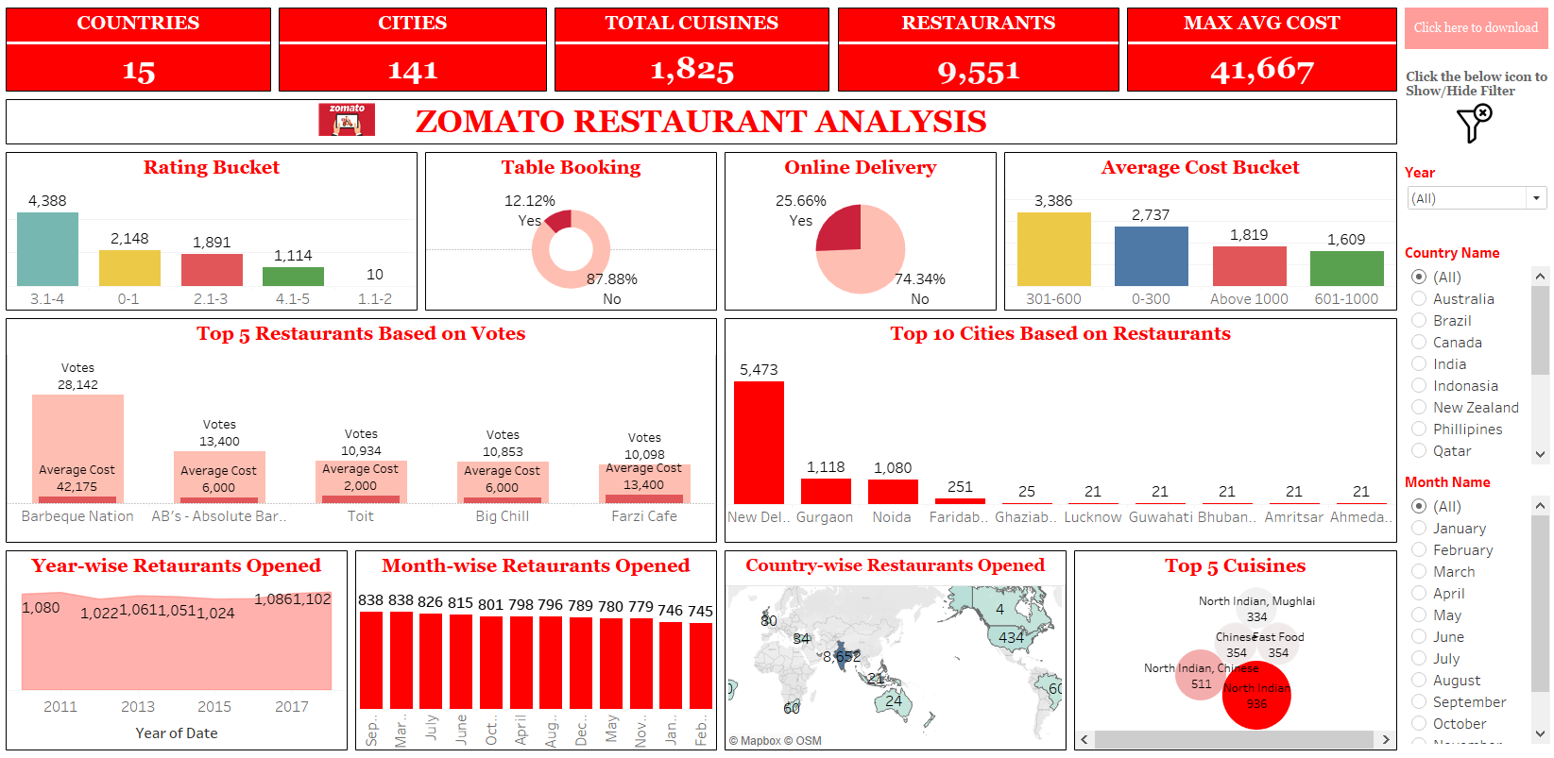
TABLEAU DASHBOARD

Slide 8
SQL Queries
Create Calendar table.
Convert the Average cost for 2 column into USD dollars and INR
Number of Restaurants based on City and Country.
Number of Restaurants opening based on Year , Quarter , Month
Count of Restaurants based on Rating bucket
Count of Restaurants based on Cost bucket
Percentage of Restaurants based on "Has_Table_booking”
Percentage of Restaurants based on "Has_online_delivery“
Rank Top 5 Cuisines based on Restaurant count
Rank Top 10 Restaurants based on Votes
Restaurants, Cuisines, Country, City, Votes, Average rating, Total Cost (INR), Total Cost(USD)

Slide 9
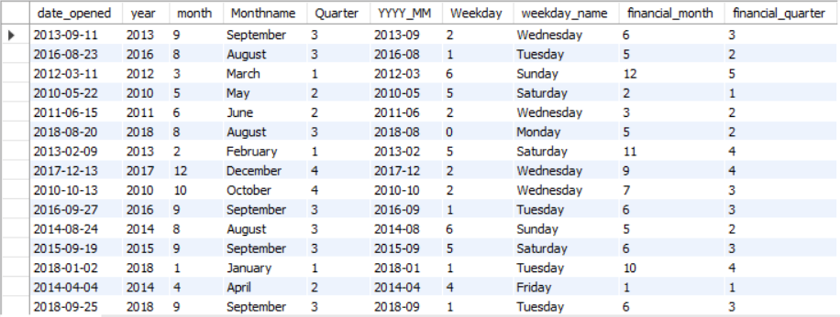
1. Create Calendar table: Alter table main_table add column Date_opened date; Update main_table Set date_opened= STR_TO_DATE(Concat(year, '-’, Lpad(month, 2, '0'), '-’, Lpad(day, 2, '0')), '%Y-%m-%d’); Create table calendar as(select date_opened,year, month ,monthname(date_opened) as Monthname, quarter(date_opened) as Quarter, concat(year,'-’,Lpad(month, 2, '0')) as YYYY_MM, weekday(date_opened) as Weekday, dayname(date_opened) as weekday_name, Case When Month(date_opened) >= 4 Then Month(date_opened) – 3 Else Month(date_opened) + 9 End as financial_month, Case When Month(date_opened) >= 4 Then Floor((Month(date_opened) - 3) / 3) + 1 Else Floor((Month(date_opened) + 9) / 3) + 1 End as financial_quarter from main_table);
Result:

Slide 10
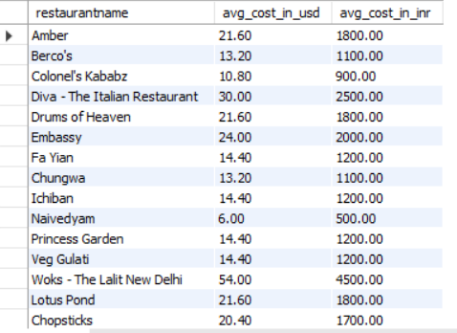
2. Convert the Average cost for 2 column into USD dollars and INR : select m.restaurantname, round((m.average_cost_for_two*c.usd_rate),2) as avg_cost_in_usd, round(((m.average_cost_for_two*c.usd_rate)/.012),2) as avg_cost_in_inr from main_table m join currency c on m.currency=c.currency;
Result:

Slide 11
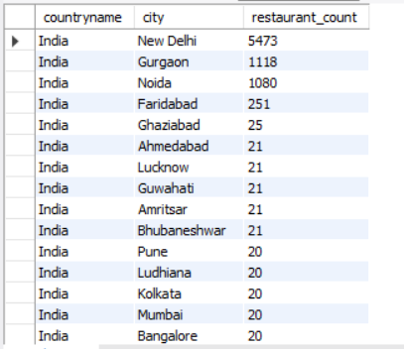
3. Number of Restaurants based on City and Country select c.countryname, m.city, count(m.restaurantid) as restaurant_count from main_table m join country c on m.countrycode = c.countryid group by 1,2 order by 3 desc;
Result:

Slide 12
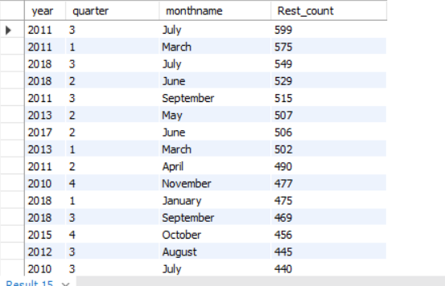
4. Number of Restaurants opening based on Year , Quarter , Month select c.year,c.quarter,c.monthname, count(m.restaurantid) as Rest_count from main_table m join calendar c on m.date_opened=c.date_opened group by 1,2,3 order by 4 desc;
Result:

Slide 13
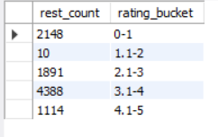
5. Count of Restaurants based on Rating bucket select count(restaurantname) as rest_count, case when rating<=1 then "0-1“ when rating>1 and rating<=2 then "1.1-2“ when rating>2 and rating<=3 then "2.1-3“ when rating>3 and rating<=4 then "3.1-4“ else "4.1-5“ end as rating_bucket from main_table group by 2 order by rating_bucket;
Result:

Slide 14
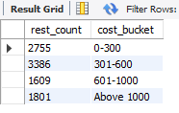
6. Count of Restaurants based on Cost Bucket select count(m.restaurantname) as rest_count, case when ((m.average_cost_for_two*c.usd_rate)/.012)<=300 then "0-300“ when ((m.average_cost_for_two*c.usd_rate)/.012)>300 and ((m.average_cost_for_two*c.usd_rate)/.012)<=600 then "301-600“ when ((m.average_cost_for_two*c.usd_rate)/.012)>600 and((m.average_cost_for_two*c.usd_rate)/.012)<=1000 then "601-1000“ else "Above 1000“ end as cost_bucket from main_table m join currency c on m.currency=c.currency group by 2 order by cost_bucket;
Result:

Slide 15
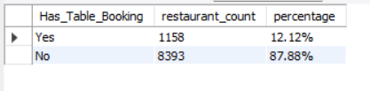
7. Percentage of Restaurants based on "Has_Table_booking” Select Has_Table_Booking,Count(*) AS restaurant_count, concat(Round((Count(*) * 100.0 / (Select count(*) From main_table)), 2),"%") as percentage From main_table group by Has_Table_Booking;
Result:

Slide 16
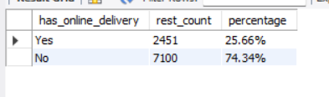
8. Percentage of Restaurants based on "Has_online_delivery“ select has_online_delivery, count(*) as rest_count, concat(round((count(*)*100)/(select count(*) from main_table),2),"%") as percentage from main_table group by 1;
Result:

Slide 17
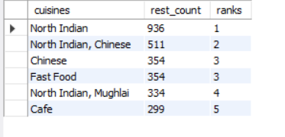
9. Rank Top 5 Cuisines based on Restaurant count select * from (select cuisines, count(restaurantid) as rest_count , dense_rank() over (order by count(restaurantid) desc) as ranks from main_table group by 1) as cuisines where ranks<=5;
Result:

Slide 18
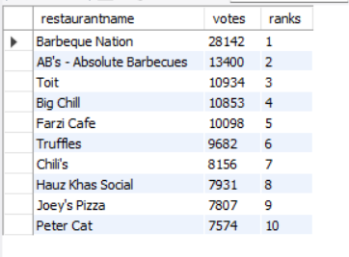
10. Rank Top 10 Restaurants based on Votes select * from (select restaurantname, sum(votes) as votes, dense_rank() over (order by sum(votes) desc) as ranks from main_table group by 1) as votes where ranks<=10;
Result:

Slide 19
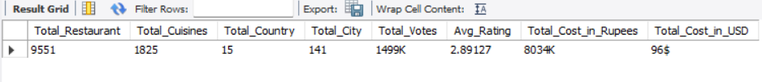
11. Restaurants, Cuisines, Country, City, Votes, Average rating, Total Cost (INR), Total Cost(USD) Select Count(RestaurantID) as Total_Restaurant, Count(Distinct Cuisines) as Total_Cuisines, Count(Distinct CountryCode) As Total_Country, Count(Distinct City) As Total_City, Concat(Round(Sum(Round(Votes)) / 1000), 'K’) As Total_Votes, Avg(Rating) As Avg_Rating, Concat(Round(Sum(Round(Indian_RupeesCost)) / 1000), 'K’) As Total_Cost_in_Rupees, Concat(Round(Sum(Round(USDCost)) / 1000), '$') As Total_Cost_in_USD from main;
Result:

Slide 20
BUSINESS IMPLICATION
STRATEGIES
Improve Customer Experience
Expand Online and Table Booking Services
Enhance Market Penetration
Optimize Pricing Strategy

Slide 21
Challenges Faced & Solution
Low Average Rating
Solution: Conduct sentiment analysis on reviews to identify common complaints and address them through menu improvements, better service, or targeted promotions.
Limited Online Delivery
Solution: Encourage more restaurants to partner with delivery platforms
Imbalance in Table Booking Preferences
Solution: Implement a user-friendly booking system and offer incentives for pre-booking.
High Concentration in Certain Cities
Solution: Expand marketing efforts and partnerships in underrepresented cities.

Slide 22
CONCLUSION
The Zomato Restaurant Analysis highlights key insights into restaurant distribution, customer preferences, and service gaps.
The low average rating and limited adoption of online services suggest an opportunity for restaurants to enhance customer experience and embrace digital transformation.
The inclusion of rating and voting data highlights the importance of customer feedback in maintaining service quality.
North Indian and Chinese cuisines are customer favorites.
Ratings and pricing significantly influence customer choice

Slide 23
Insights and Recommendations
Customer Engagement
Technology Integration
Geographical Expansion
Service Quality Improvement
Marketing and Awareness

Slide 24
THANK YOU

